Slide 1
Problem: ANN correction adds non zero-mean

Slide 2
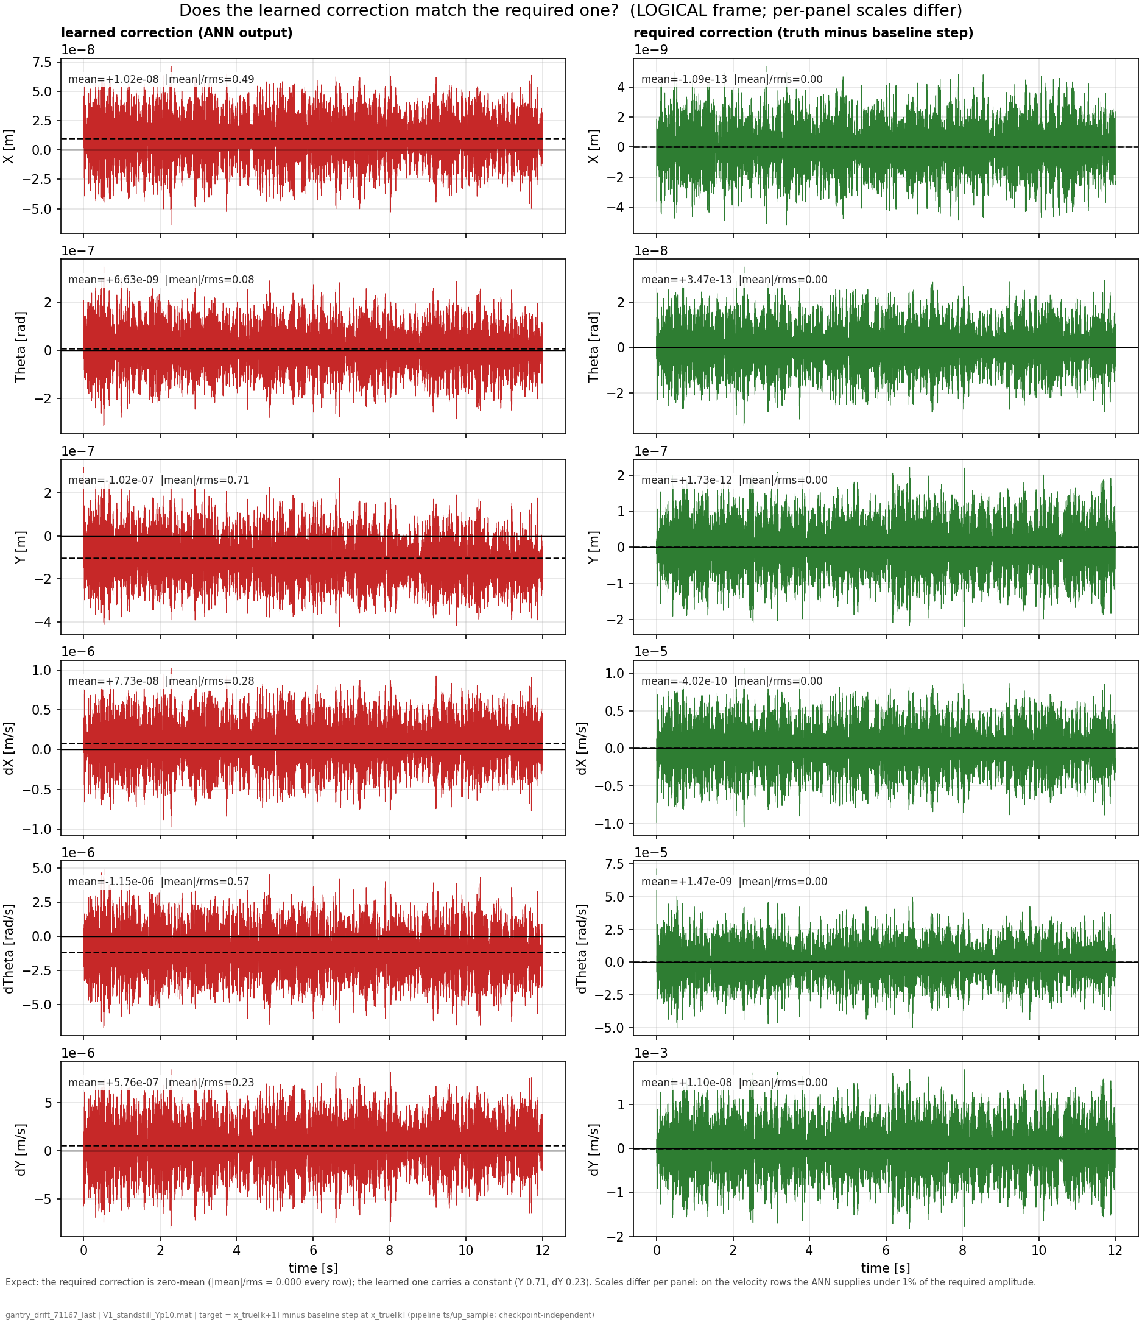
Compare ANN output against perfect correction
For reference:
  The correct correction for the ANN is zero-mean
Truth - baseline = zero-mean

Slide 3
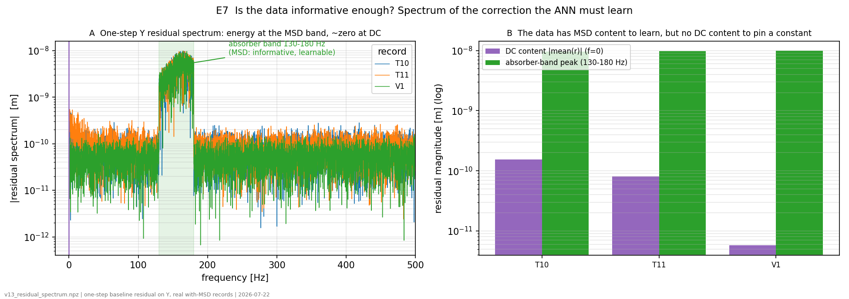
Is the data informative enough?

Slide 4
To be discussed
Issue in the code creating the offset?
Training: flat landscape

Slide 5
Offset in the code
Does the code implementation cause an offset?
  Currently not found any issues in the code
Compare ANN output for baseline (without MSD) and compare against the system with MSD
Intentionally inject a known offset and see whether the ANN recovers this
  If we only see this behaviour for the injected offset and not in “offset free” baseline this would indicate it is not a code issue
Y and X are the states without stiffness (K=0)
  dY carries the dominant DC
    I also added single panels for dY to see it more clearly
  (The hidden absorber MSD is coupled to Y)

Slide 6
Code creating offset
  Model matches system
  Inject offset
Flat loss landscape → learns dc, is consistent
Data informative enough to learn the MSD?

Slide 7
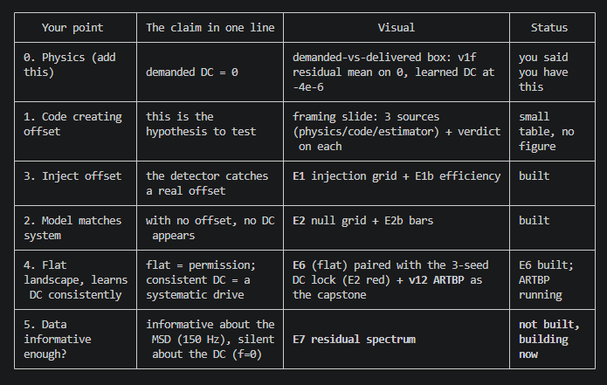

Slide 8
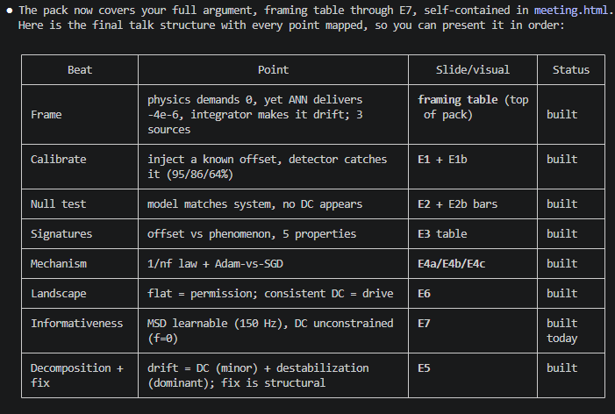

Slide 9
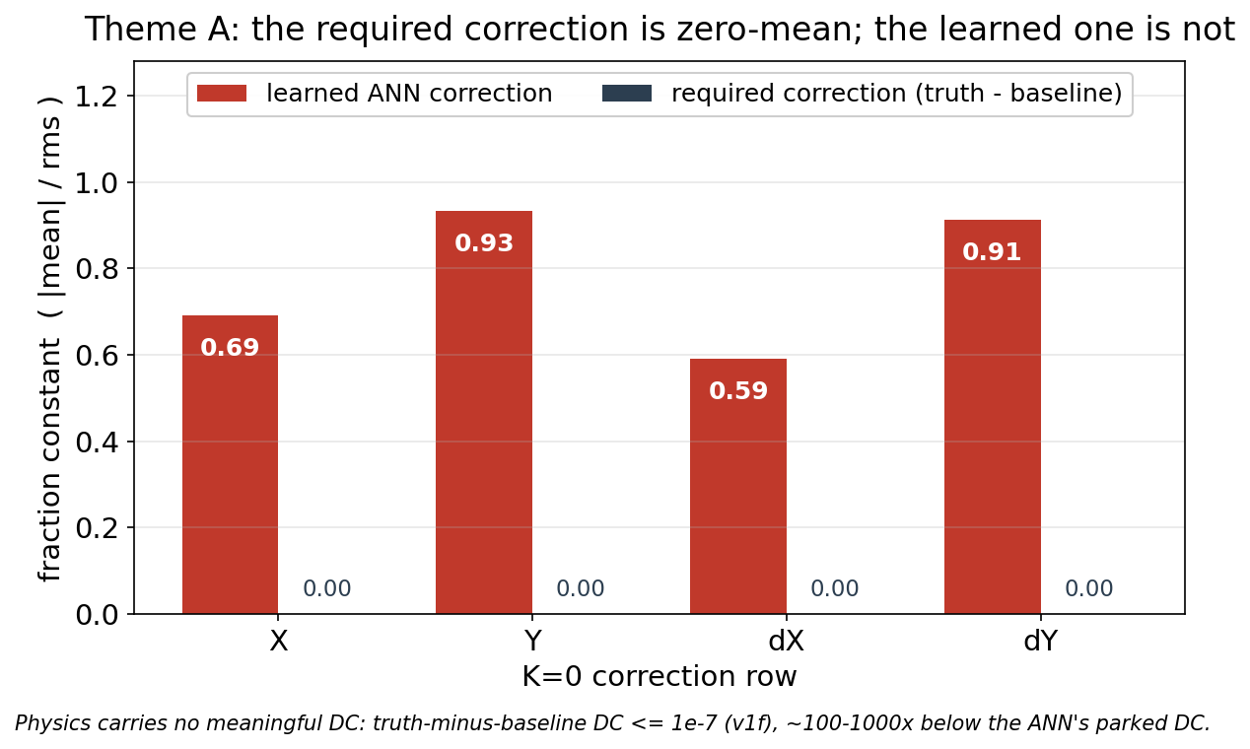
Required correction is zero-mean
For optimal augmentation

Slide 10
System == model:
  means the data was created in python with ANN-off
  “clean pipeline” also uses this data
Matlab no-MSD data:
  Simulink closed-loop run without the added MSD

Slide 11
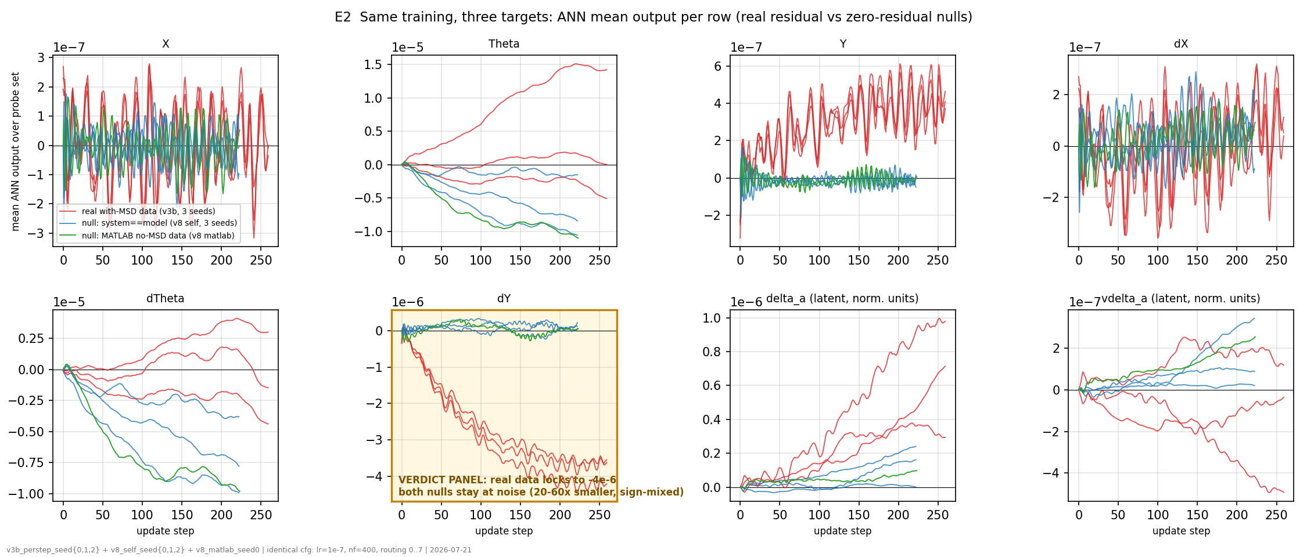
Identical training for all 3 methods. Need to look at the K=0 rows (X, Y, dX, dY): with the real absorber residual (red) the dY DC locks negative and grows to ~-4e-6.
The stiff Theta rows show that a constant forms in ALL 3, its output effect is bounded by the Theta stiffness and produces no drift.

Slide 12
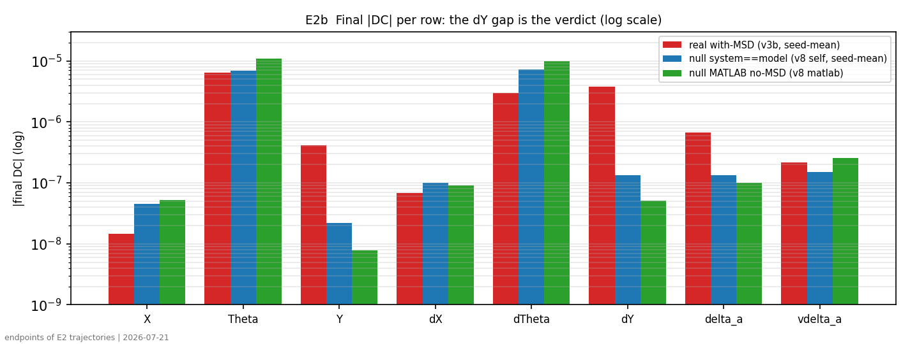
Y and dY stand out. But the added MSD is also added to the payload Y and the original payload mass is split over MSD and the new payload mass, 10 and 90 percent respectively. It should only affect the center of mass.
  But looking at the actual system (next page) the system is zero-mean, and the earlier image for the correct ANN (truth-baseline) also showed this

Slide 13
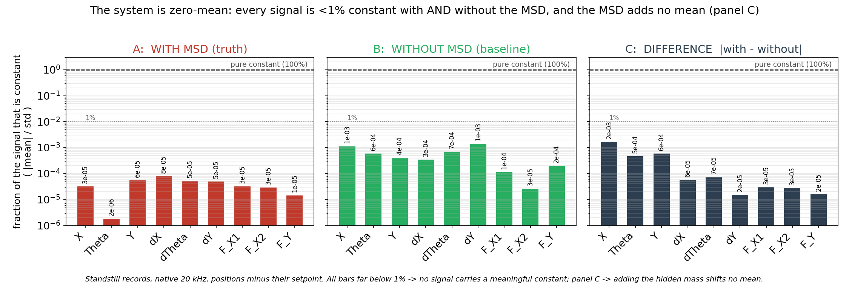
Note: minus the setpoint; NOT the signal’s own time-mean
Standstill operating points: T1_standstill_Ym30, T2_standstill_Ym15, T3_standstill_Y000, T4_standstill_Yp15, T5_standstill_Yp30

Slide 14
Question: Is minus the setpoint biased?

Slide 15


Slide 16


Slide 17
The Y seems to find a new offset point and not grow further but oscillate around the new point, but the system seems to be zero-mean. Unless minus set point is biased.
Question: If it’s a next state issue it should keep getting worse no?
  Since the Y is being scheduled each update step, so error keeps growing.

Slide 18
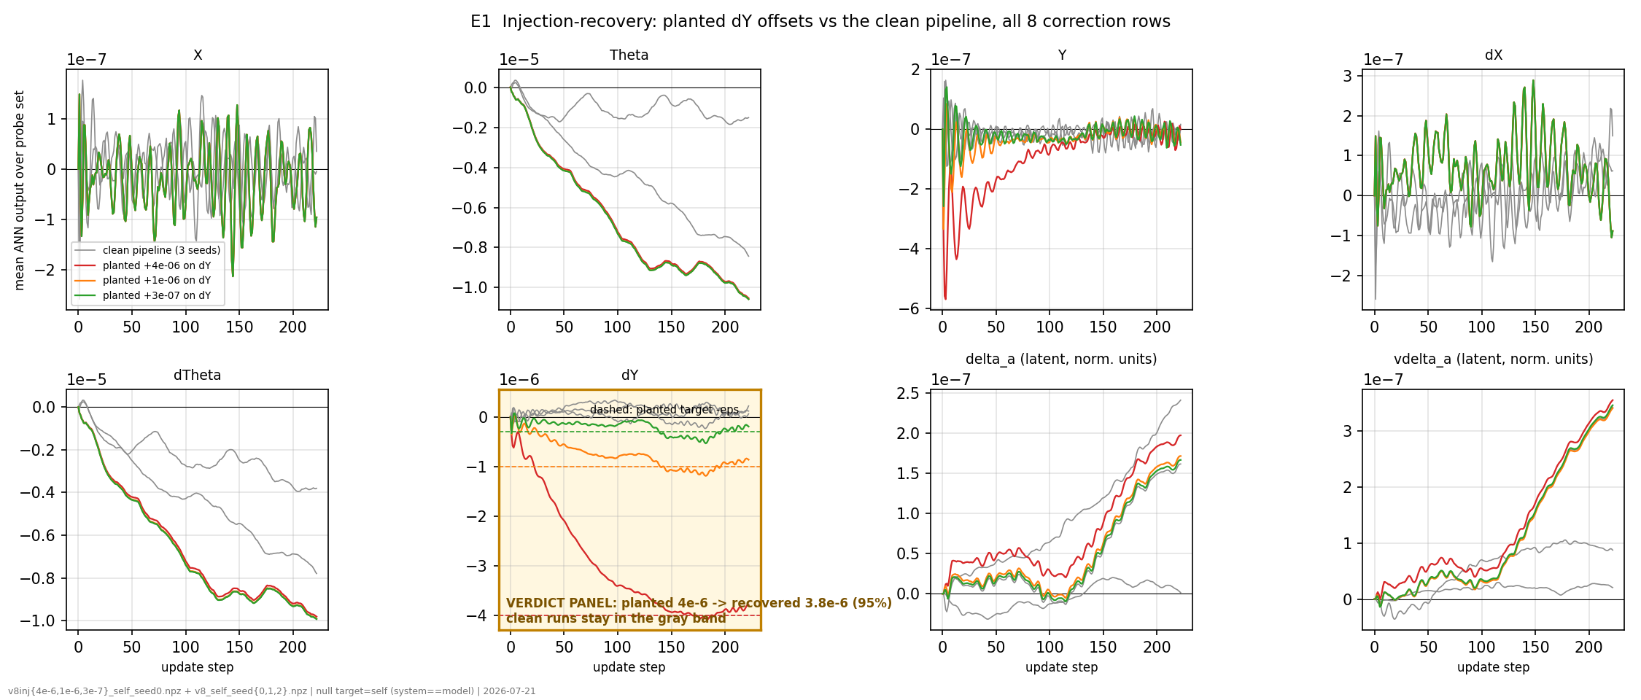
Inject a constant planted on the dY row
Every single timestep, +ε is added to the dY (Y-velocity) component of the model's state, on top of whatever the baseline and ANN computed. Nothing is added to the other 7 rows, nothing to the input u, nothing to the output y.

Slide 19
The dY row keeps growing, but Y gets back to 0.
  But with the MSD data mismatch with the model and we keep propagating the wrong Y.

Slide 20
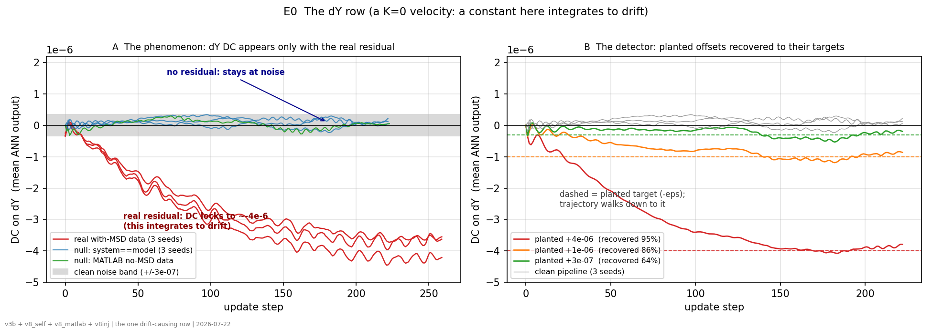
dY with K=0, for this velocity a constant integrates into position drift.
Left: the DC forms only when the real absorber residual is in the loss.
Right: planted offsets are recovered to their targets (95/86/64%), and the clean pipeline stays flat.

Slide 21
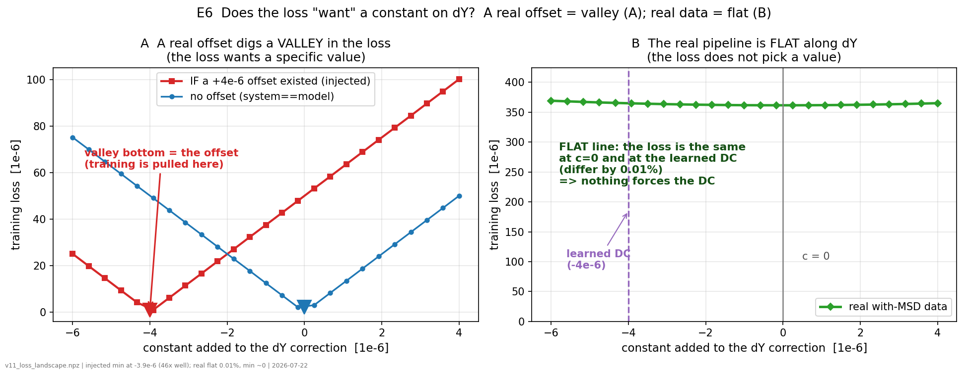
The loss landscape
Evaluation sweep, not training: no gradients and no optimizer.
We take the fixed baseline model and simply measure the loss for each candidate value of the constant.
Flat loss landscape, Adam is free to wander. The loss does not pin it.

Slide 22
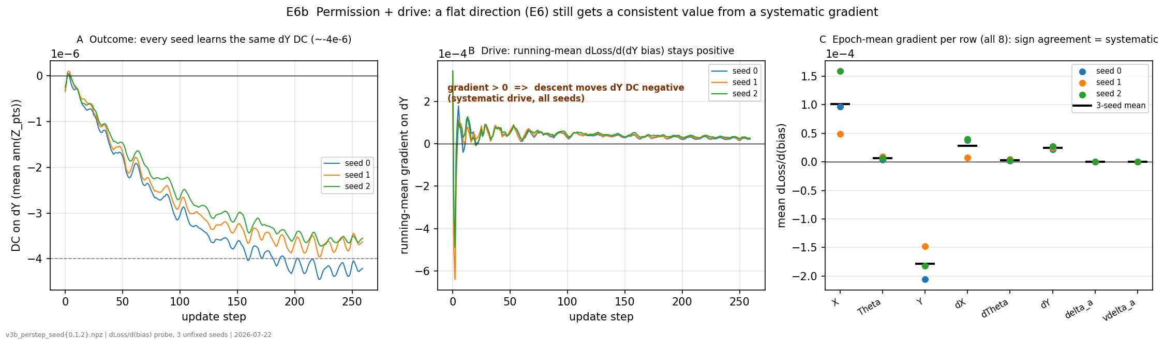
The behaviour is systematic.
Left: every seed learns the same dY DC.
Middle: the running-mean gradient on the dY constant stays positive in all seeds (a positive gradient drives the DC negative under descent), so the drive is systematic, not random.
Right: the epoch-mean gradient per row agrees in sign across seeds on the K=0 rows (dY especially)

Slide 23
Question: Systematic gradient caused by the truncated-BPTT bias? Increasing nf did not help.

Slide 24
Anticipated Reweighted Truncated Backpropagation (ARTBP)
Training on short windows (truncated BPTT) gives a biased gradient: it under-weights long-timescale effects, so it rewards a constant velocity that helps inside the 0.1 s window but drifts over the full 12 s run.
ARTBP removes that bias at the same average cost: instead of a fixed window, it draws a random horizon (short on average, occasionally long) and reweights each step so the gradient is unbiased for the full horizon.
Notes:
ARTBP, one window at a timeSetup (choose once): the stopping rule. Decide the per-step chance of stopping the rollout. This is the only thing that differs between geom and poly:- geom: same stopping chance every step (1/400).- poly4/poly6: stopping chance that shrinks the longer you have gone.
Step 1: Draw a random rollout length K. Walk forward step by step; at each step flip the stopping coin. Stop the first time it comes up heads. Usually this happens early (short window), occasionally very late (long window). Cap it at 1600 steps, floor it at 2.
Step 2: Roll out the model K steps. Run the augmented model forward for those K steps and record the prediction error at each step (the per-step loss).
Step 3: Reweight each step. Multiply step t's loss by 1 / (probability of having reached step t). Early steps get weight â 1; the rare late steps get a big weight, so they stand in for all the times you stopped short of them.
Step 4: Sum and backprop. Add up the reweighted per-step losses into one number, backpropagate through the K-step rollout to get the gradient, and take one Adam step.
Step 5: Repeat over many windows. Each window is cheap on average (mean length 400), but because the rare long windows are boosted, the average gradient over all windows equals the true full-horizon gradient. That is what makes it unbiased at short-window cost.
The whole loop in pseudocode-plain-Englishfor each training window:
K = draw a random length # usually short, rarely long, capped at 1600
roll out the model for K steps, collect per-step errors
weight each step by 1 / P(reached that step) # rare late steps count extra
loss = sum of weighted errors
backprop through the K steps, Adam stepThe one idea holding it together: any single window is biased (short ones miss the long-run drift, long ones over-represent it), but the reweighting makes the average across windows exactly the full-horizongradient. You get the long-horizon signal without ever paying for a long window every time.

Slide 25
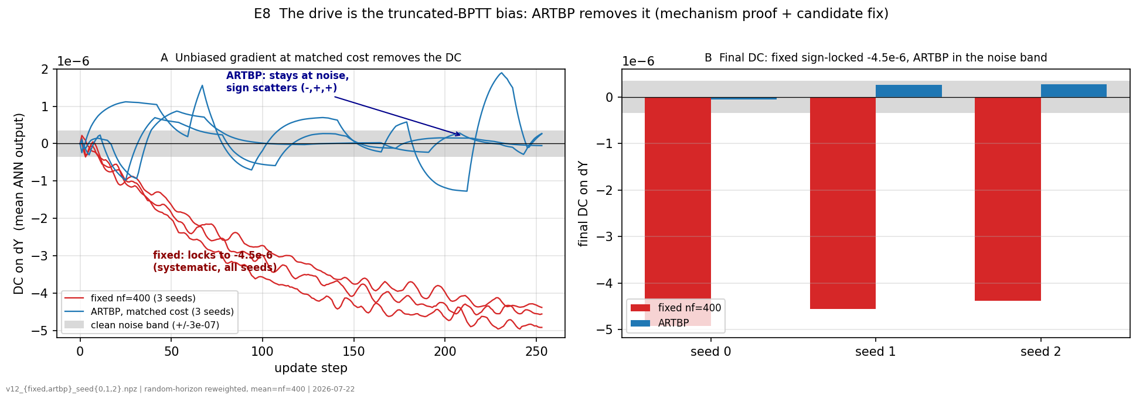
The flat direction plus a systematic gradient produce the DC. That gradient is the finite-window (truncated-BPTT) bias. ARTBP samples the rollout horizon randomly (same average cost as nf=400) and reweights so the gradient is unbiased for the long horizon.
Result: the fixed control locks to -4.5e-6 on all three seeds (systematic), while ARTBP collapses into the noise band and its sign scatters (-,+,+): the systematic drive is gone.
Takeaway: The systematic DC is caused by the truncation bias (remove the bias → the DC vanishes).
  Longer fixed windows could not fix it.
Notes:
ARTBP, one window at a timeSetup (choose once): the stopping rule. Decide the per-step chance of stopping the rollout. This is the only thing that differs between geom and poly:- geom: same stopping chance every step (1/400).- poly4/poly6: stopping chance that shrinks the longer you have gone.
Step 1: Draw a random rollout length K. Walk forward step by step; at each step flip the stopping coin. Stop the first time it comes up heads. Usually this happens early (short window), occasionally very late (long window). Cap it at 1600 steps, floor it at 2.
Step 2: Roll out the model K steps. Run the augmented model forward for those K steps and record the prediction error at each step (the per-step loss).
Step 3: Reweight each step. Multiply step t's loss by 1 / (probability of having reached step t). Early steps get weight â 1; the rare late steps get a big weight, so they stand in for all the times you stopped short of them.
Step 4: Sum and backprop. Add up the reweighted per-step losses into one number, backpropagate through the K-step rollout to get the gradient, and take one Adam step.
Step 5: Repeat over many windows. Each window is cheap on average (mean length 400), but because the rare long windows are boosted, the average gradient over all windows equals the true full-horizon gradient. That is what makes it unbiased at short-window cost.
The whole loop in pseudocode-plain-Englishfor each training window:
K = draw a random length # usually short, rarely long, capped at 1600
roll out the model for K steps, collect per-step errors
weight each step by 1 / P(reached that step) # rare late steps count extra
loss = sum of weighted errors
backprop through the K steps, Adam stepThe one idea holding it together: any single window is biased (short ones miss the long-run drift, long ones over-represent it), but the reweighting makes the average across windows exactly the full-horizongradient. You get the long-horizon signal without ever paying for a long window every time.

Slide 26
LPV Y scheduling variable
What is causing the growing error
Window too short?
State-transition Jacobian
  Look at model + ANN
  Answers whether it’s an instability issue or window issue?

Slide 27
Anticipated Reweighted Truncated Backpropagation (ARTBP)
e
Unbiasing Truncated Backpropagation Through Time
Corentin Tallec, Yann Ollivier
Source: https://arxiv.org/abs/1705.08209

Slide 28
- Theta and dTheta are sprung (stiffness kb1+kb2). A constant here produces a bounded static deflection (roughly c/k), which the spring holds. It does not integrate. So even though the Theta DC is bigger, its effect is bounded and harmless.
One thing to note that actually supports the argument: in the Theta panel, the clean runs and the injected runs drift together, identically. The dY injection did not change Theta at all. That shows the injection is specific to dY (which is the point), and that the Theta walk is a separate, condition-independent optimizer artifact on a harmless axis.
The green curve (+3e-7) looking like the clean pipelineThat is the detection limit, and it is deliberate. The planted +3e-7 is so small that the recovered DC (-1.9e-7) barely rises above the clean pipeline's own noise wander (~1e-7). So yes, at 3e-7 the injection blends into the noise, the detector can barely see it. That is what "detection limit ~3e-7" means:

Slide 29
New slides

Slide 30
Y-issue
Horizon of nf = 6400 is not realistic
What is causing this Y error, why does it need to be so long?
It is the self scheduling variable, maybe because we keep feeding it this, that might be the error.

Slide 31
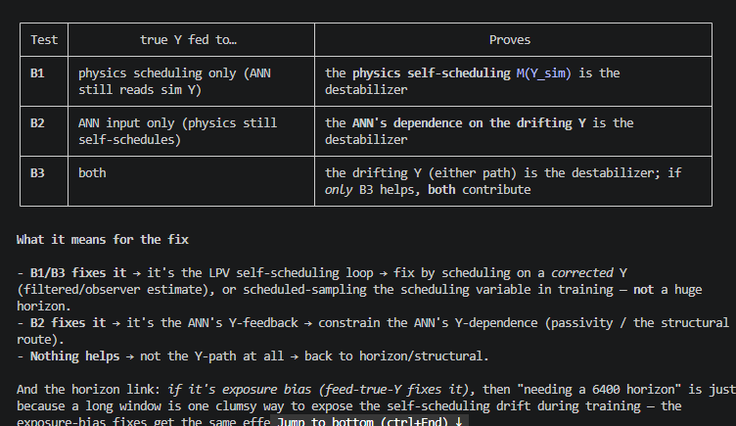

Slide 32
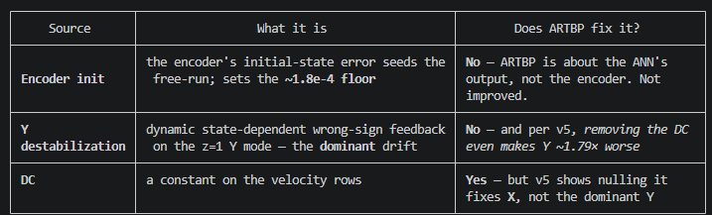
2. Why it's a problem. The Y axis is a free integrator (K=0), so a constant on the velocity integrates into unbounded position drift over a free-run. That is the harm — and this figure doesn't show the drift at all.

Slide 34
Problem 2: the dynamic destabilization of the Y mode (the one you mean)
Problem 1: the DC (constant) on dYThe truncated-BPTT-bias artifact, a constant on the K=0 Y-velocity row. This is the minor part (mostly the X-axis story), and it is what ARTBP / a DC pin addresses.
Problem 2: the dynamic destabilization of the Y mode (the one you mean)This is the dominant drift, it lives on the Y position, and removing the constant does not fix it. It is not a constant at all, it is the trained ANN's state-dependent output acting as feedback with the wrong sign/structure on the marginal z=1 Y mode, effectively nudging that zero-margin mode slightly unstable. Two measurements pin it:

Slide 35
So for the meeting, E8's claim should be scoped as "the constant on dY is a training artifact, removable by unbiasing the gradient," not "ARTBP fixes the drift." The stronger claim needs the Phase E free-run measurement, which is exactly the experiment your Y-destabilization question points at.

Slide 36
"geometrically decaying memory"
The paper bounds ARTBP's variance only for "geometrically decaying memory" (Sec 4: (1-ε)^L · L^α stays bounded). Our z=1 axis has no decay — so the marginal mode threatens variance boundedness for ARTBP itself, not just for this measurement.

Slide 37
3. Conditions: cap-reaching-the-timescale, and is variance worse?Both are the crux, and both are much harder than for the DC:- Cap. From the log, the position mode's natural timescale is ~3 s and v6 saw "Y destabilized ~114× over 2 s" → e-folding time on the order of 0.4–2 s (≈1700–8000 steps at 4 kHz). The current H_max=1600 (0.4 s) sits at the very edge — it may catch the onset but not several e-foldings. To robustly penalize the instability, ARTBP's rare long rollouts must reach several × e-folding time, i.e. H_max ≈ 4000–8000. That's 3–5× today's cap.- Variance is a bigger risk — qualitatively. For the DC the axis is marginal (ε=0), where the paper's variance bound (1−ε)^L·L^α already fails. For an active instability the memory is growing (ε<0, |λ|>1), so the compensation weight w_k (poly or geometric) multiplies an **exponentially growing** mse_k on exactly the rare long rollouts ARTBP upweights → the estimator variance can be catastrophic, far beyond the DC case. Poly-tail helps (polynomial vs exponential weights) but may be insufficient against exponential loss growth. Practical corollary: long rollouts may diverge to NaN mid-training, and the obvious patch (gradient clipping) breaks unbiasedness (the paper flags this) — so it's not a free fix.
1. Does the mechanism predict ARTBP penalizes a feedback instability, or only a constant?It predicts ARTBP penalizes any direction whose loss signature grows with horizon — that's the whole content of "truncation under-weights long-term effects." Both components qualify, but with a critical difference in how the signature grows:
- Constant on z=1 → position error grows polynomially (~c·k²). Visible even in a short window, so κ(H) is nonzero from H=400 (measured: κ(400)=314) and grows smoothly.- Wrong-sign feedback gain on z=1 → the mode is pushed to |λ|>1, so the error grows exponentially (~|λ|^k). This is invisible until the horizon reaches the e-folding time, then it dominates.

Slide 38
Relation to D-117 — this is the estimator-vs-structural fork stated cleanly:- ARTBP is the estimator family — condition training so it sees the long-horizon instability and doesn't learn the wrong-sign feedback. Expressive, but training-conditional (no guarantee), and gated on the cap/variance conditions above.
- D-117 is the structural family — make instability impossible for all weights. Note the Lipschitz cap (D-118/v6b) already failed because it's a magnitude bound on a sign problem; the correct structural comparator is passivity / pHNN (sign-aware). ARTBP could in principle succeed where Lipschitz failed, precisely because it fixes the training signal rather than capping magnitude.

Slide 39
2. Extending the instrument to a Y-feedback-gain direction (no-training test) Yes — this is B0 with the injection changed from a constant to a feedback, and it's the cheap precursor that decides everything below. Instead of route_const on the Y-route, inject g·φ(x) where φ is the destabilizing state: - Primary: φ = dY (anti-damping). A learned ANN most naturally destabilizes a lightly-damped marginal mode by opposing its (tiny) damping: force = +g·dY, g>0 → negative net damping → exponential growth. This is the classic z=1 destabilizer and the most likely form of the v5/v6 feedback. - Secondary: φ = Y (negative stiffness / positive position feedback).

